Slide 1

SAP Cloud Platform Solution Diagrams & Icons Guidelines v06
SAP Cloud Platform Strategy & Product Management, Platform Evangelism Team
December 12, 2018

Slide 3
Terms Of Use for the SAP Cloud Platform Solution Diagrams, Design Elements & Icons (see PDF document)
The SAP Terms of Use found here, along with the terms of use that are specific to the SAP Diagrams, Design Elements, and Icons, below, govern your use of these SAP Materials (as defined in the Terms of Use), and related Content and web pages. Unless otherwise indicated, all capitalized words used below shall have the same meanings given to such words in the SAP Terms of Use.
By attempting to access or use these SAP Materials, You agree that these Terms form a legally binding agreement between You ("You" or "Your") and SAP SE, for and on behalf of itself and its subsidiaries and affiliates (as defined in Section 15 of the German Stock Corporation Act), and You agree to be bound by these terms with respect to your use of the Diagrams and Icons. If You are accessing the SAP Materials on behalf of Your employer in your capacity as an employee, or as a consultant or agent of a third party (this third party in any of these cases being referred to as "Your Company"), You represent and warrant that You have the authority to act on behalf of and bind Your Company to these Terms, and everywhere in this Agreement that refers to 'You' or 'Your' shall also include Your Company. If You do not agree to these terms, do not attempt to access or use the SAP Materials.
You are entitled to (a) access the Diagrams, Design Elements, and Icons, and use these SAP Materials as a reference tool for activities you perform as an individual or as part of your employment, and (b) include these SAP Materials in documents, reports, or other works that you create in direct or indirect support of the deployment or use of SAP products or services (including a third party’s deployment or use of SAP products or services). The above described use is subject to SAP’s policies on the Use of Copyrighted Material found at this page https://www.sap.com/corporate/en/legal/copyright/use-of-copyrighted-material.html including the following conditions set forth in Section II:
The SAP Materials and all copies shall remain at all times the exclusive property of SAP SE and/or an SAP affiliate company.
You must use the SAP Materials without modification (except as may be necessary to resize or otherwise convert the SAP Material to a permitted format).
In the event You use more than an incidental number or terms or definitions in your work, You must include the statement indicating the SAP Materials are “Used with permission of SAP SE” in a prominent location.
You may not use the SAP Material in any offensive manner or context, for example in a way that is defamatory, disparaging or libelous to, or otherwise presents false or misleading information regarding, SAP or any other party, or its or their products or services; in conjunction with obscene or pornographic material; in a manner that suggests bias based on race, national origin, gender, sexual orientation, or religion; or in any manner that would be illegal under applicable law.
You may not imply any SAP sponsorship, affiliation or endorsement.
You may not use the SAP Material for a purpose competitive with SAP or its products unless otherwise clearly permitted by applicable law.
You may not use the SAP corporate logo.
No use of other SAP trademarks is granted under this section. For information regarding use of SAP trademarks, see http://www.sap.com/corporate/en/legal/trademark.html.
You are not permitted to:
Archive or download the Diagrams, Design Elements, and Icons, or archive or download data to create a derivative database or work, other than as expressly permitted herein; or
Use the Web Site or any SAP Materials to provide products or services to anyone outside your organization, except as expressly provided herein or with the prior written authorization of SAP

Slide 4
SAP Cloud Platform Solution Diagrams & Icons Guidelines Readme
Official SAP design guidelines & icons to create SAP Cloud Platform Solution Diagrams using MS PowerPoint.
Reach a better and faster understanding of SAP Cloud Platform end-to-end solution scenarios as customer, partner, client, solution architect, project lead or developer by using graphical diagrams for visual learning.
Accelerate learning curve for customers & partners with common iconography and solution diagram design following SAP Cloud Platform UX principles (Fiori design).
Use the MS PowerPoint slide deck SAP-Cloud-Platform_official-solution-diagrams-and-icons_v06.pptx available for download on public wiki page SAP Cloud Platform Solution Diagrams & Icons
Find the icon, diagram element or sample diagram that you need
Create your own SAP Cloud Platform solution diagram for own purposes including twitter, sap.com blogs, project documentation, interactions with clients, workshops
For more information see public wiki SAP Cloud Platform Solution Diagrams & Icons
Or directly contact Bertram Ganz via email bertram.ganz@sap.com
Yours SAP Cloud Platform Strategy & PM team

Slide 5
SAP Cloud Platform Solution Diagrams & Icons Guidelines Table of Contents
SAP Icons & Logos
SAP Cloud Platform Capability Icons
SAP Cloud Platform Service Icons (for Diagrams & Slides)
SAP Icons
SAP Logos
Third-Party Logos
Whitelisted Third-Party Logos
Elements for MS PowerPoint Slides
Colors
Areas, Cardinality Markers, Environment Areas
Text in Flex Grey
Text in L0-blue, Emphasize & Semantic Colors
Connectors, Arrows & Lines
Numbers
Design Guidelines
Elements for Protocols, Interfaces & Trust Relationships
Style to Show Inner Part of Application or Service
Arrow Directions
Do’s & Don’t
Tips & Tricks
How to create Colored Icons in 5 Steps
Comparison with SAP TAM Block Diagrams
Community Support
Solution Diagram Examples
Resources
Version Change History

Slide 6
SAP Cloud Platform Solution Diagrams & Icons SAP Icons & Logos
TOC | SAP Icons & Logos | 3rd Party Logos | Slide Elements | Guidelines | Examples | Resources | Changes

Slide 7
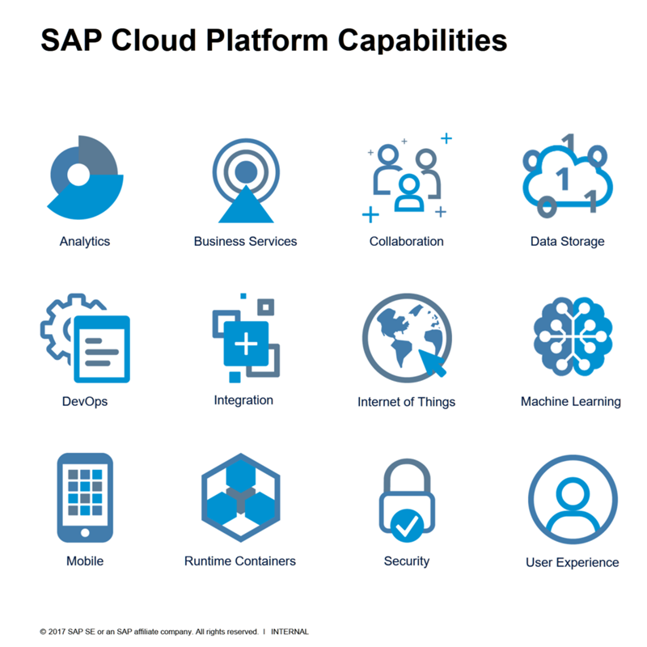
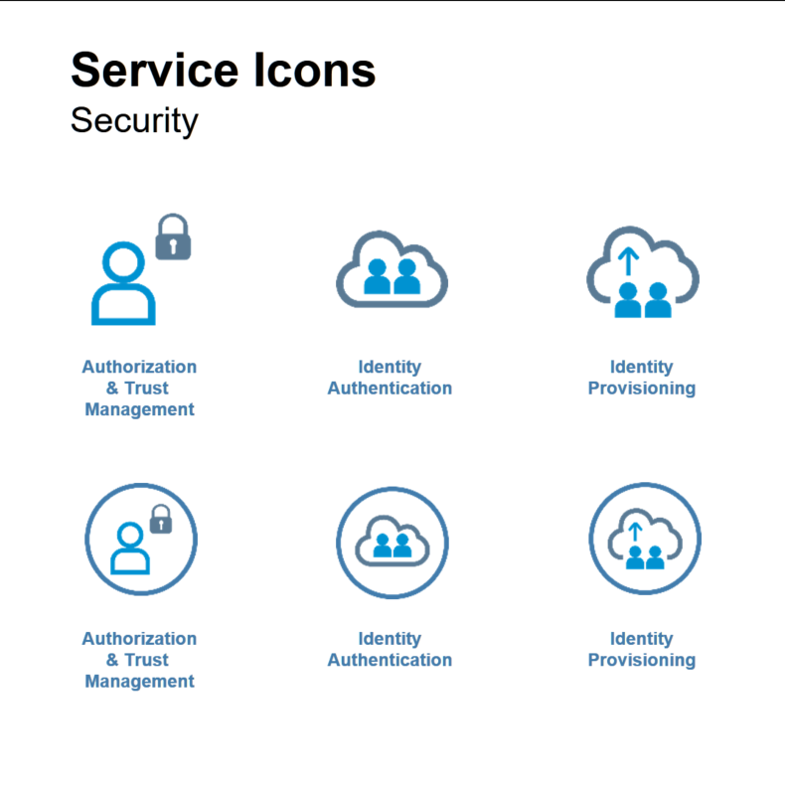
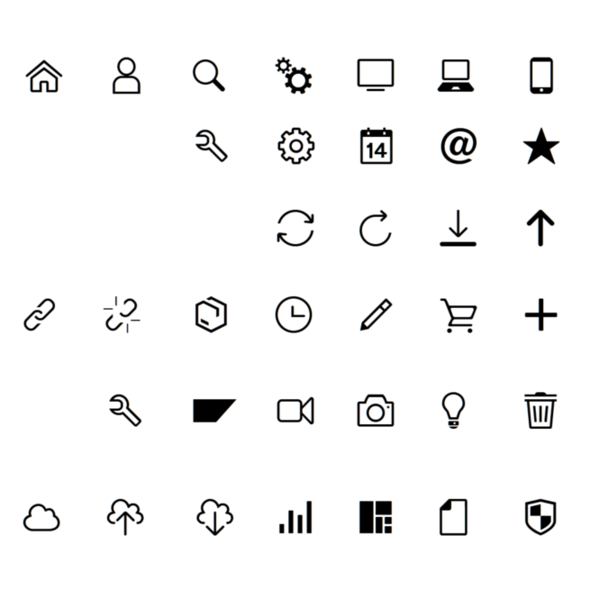
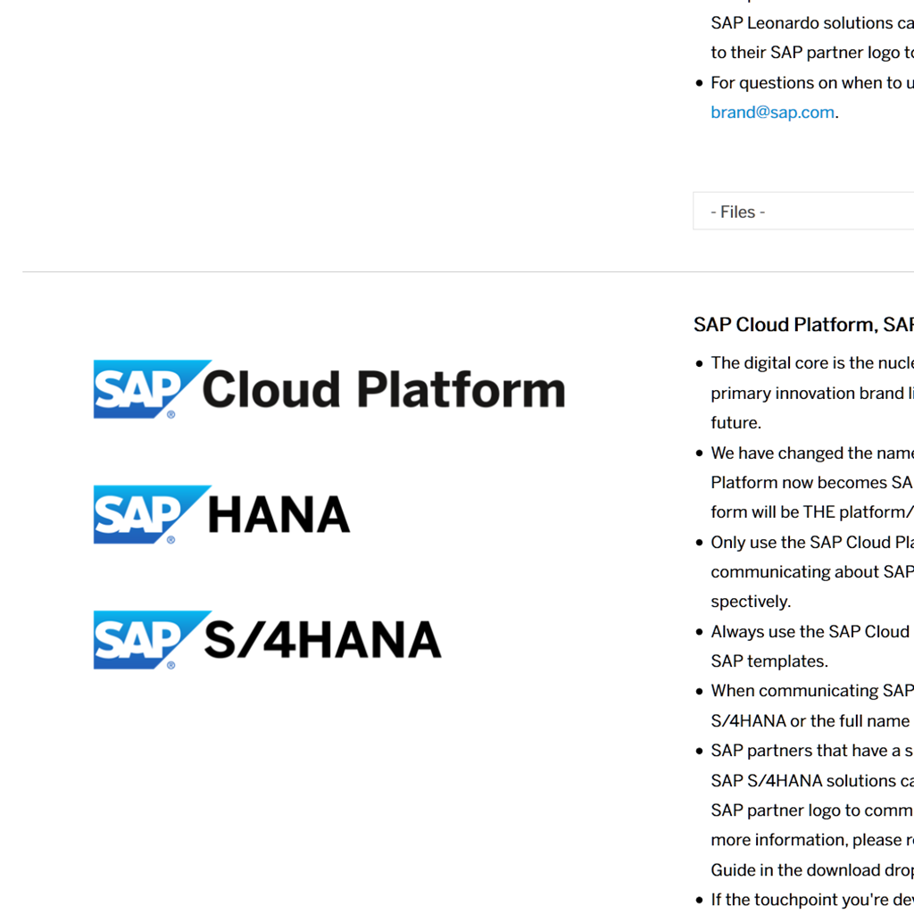
SAP Cloud Platform Solution Diagrams & Icons SAP Icons & Logos
Capability Icons
Service Icons
Other SAP Icons
SAP Logos
SAP Cloud Platform Capabilities, e.g. Analytics, Internet of Things, Collaboration
SAP Cloud Platform Service Icons, e.g. Connectivity Service, SAP Web IDE for diagrams (with circle) and slides (without circle)
SAP Icons taken from SAP’s own icon fonts like SAP Icon Font or TNT Font
Logos for SAP Products like SAP Cloud Platform, SAP SuccessFactors

Slide 8























SAP Cloud Platform Solution Diagrams & Icons SAP Cloud Platform Capability Category Icons*
* read more about SAP Cloud Platform Capabilities here … https://cloudplatform.sap.com/capabilities.html
Capability Categories
Other Icons*
*the below icons do not represent SAP Cloud Platform capability categories but are used to depict related topics
Analytics
Blockchain
Collaboration
Commercialization
Data Management
Data Privacy & Security
Developer Experience
Dev / Ops
Document Management
Globalization
Integration
Internet of Things
LoBs & Industries
Machine Learning
Master Data
Mobile
Orchestration
Output Management
Rates & Measures
Runtimes & Containers
User Experience
User Management
Infrastructure

Slide 9



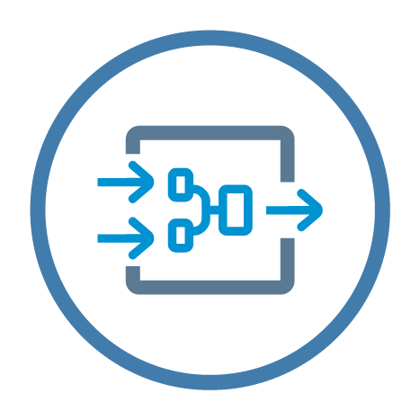




SAP Cloud Platform Solution Diagrams & Icons SAP Cloud Platform Service Icons for Solution Diagrams
Analytics
Blockchain
SAP Predictive Service
SAP Analytics Cloud
Smart Business Service
SAP Streaming
Analytics
MultiChain
Hyperledger Fabric
Blockchain Application Enablement
SAP RealSpend
* read more about SAP Cloud Platform Services here … SAP Cloud Platform Help: Services

Slide 10











SAP Cloud Platform Solution Diagrams & Icons SAP Cloud Platform Service Icons for Solution Diagrams
Collaboration
Data Management
Feedback Service
Gamification
Intelligent Product Design
SAP Jam
Big Data
Services
MongoDB
Object Store
SAP ASE
SAP HANA
PostgreSQL
Redis
* read more about SAP Cloud Platform Services here … SAP Cloud Platform Help: Services

Slide 11

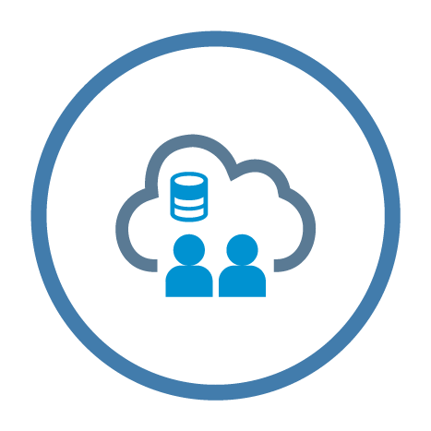









SAP Cloud Platform Solution Diagrams & Icons SAP Cloud Platform Service Icons for Solution Diagrams
Data Privacy & Security
Developer Experience
Authorization & Trust Management
Identity Directory
Platform Identity Provider
Keystore Service
Corp. Git Link for SAP Web IDE
Git Service
Java Debugging
SAP RAD by Mendix
SAP Web IDE
SAP Web IDE Full-Stack
OAuth 2.0 Service
SAP Live Link 365 for Authentication
* read more about SAP Cloud Platform Services here … SAP Cloud Platform Help: Services

Slide 12















SAP Cloud Platform Solution Diagrams & Icons SAP Cloud Platform Service Icons for Solution Diagrams
DevOps
Agent Activation for Dynatrace
Application Autoscaler
Application Logging
Enhanced Disaster Recovery
Feature Flags Service
High Availability Option
Java Apps Lifecycle Management
Job Scheduler
Monitoring Service
Performance Statistics Service
Profiling Service
Solutions Lifecycle Management
Transport Management
Custom Domains
* read more about SAP Cloud Platform Services here … SAP Cloud Platform Help: Services

Slide 13




SAP Cloud Platform Solution Diagrams & Icons SAP Cloud Platform Service Icons for Solution Diagrams
Globalization
Document Management
SAP Localization Hub, Tax Service
SAP Translation Hub
SAP Document Center
Document Service
* read more about SAP Cloud Platform Services here … SAP Cloud Platform Help: Services

Slide 14




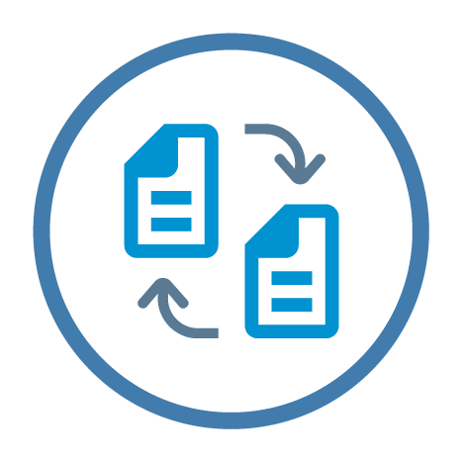










SAP Cloud Platform Solution Diagrams & Icons SAP Cloud Platform Service Icons for Solution Diagrams
Integration
Internet of Things
API Management
SAP API Business Hub
SAP Banking API
SAP Enterprise Messaging
Internet
Of Things
SAP Remote Data Sync
SAP Asset
Intelligence Network
SAP IoT Application Enablement
Cloud Integration
Connectivity
OData Provisioning
Open Connectors
RabbitMQ
Digital Content Hub
Destination
Backend Service
* read more about SAP Cloud Platform Services here … SAP Cloud Platform Help: Services

Slide 15


SAP Cloud Platform Solution Diagrams & Icons SAP Cloud Platform Service Icons for Solution Diagrams
Machine Learning
Master Data
SAP Leonardo
Machine Learning Foundation
SAP Data Quality Management, microservices for location data
* read more about SAP Cloud Platform Services here … SAP Cloud Platform Help: Services

Slide 16







SAP Cloud Platform Solution Diagrams & Icons SAP Cloud Platform Service Icons for Solution Diagrams
Mobile
Orchestration
Agentry
Development & Operations
SMS Messaging
Business Rules
Workflow
Deprecated icons (services either removed from catalog** or subsumed by other service***)
App & Device** Management
Fiori Mobile***
*** subsumed in Mobile Service for Development & Operations
* read more about SAP Cloud Platform Services here … SAP Cloud Platform Help: Services

Slide 17



SAP Cloud Platform Solution Diagrams & Icons SAP Cloud Platform Service Icons for Solution Diagrams
Output Management
Rates & Measures
Live Link for IN365-Email
Forms by Adobe
Market Rates Management
* read more about SAP Cloud Platform Services here … SAP Cloud Platform Help: Services

Slide 18







SAP Cloud Platform Solution Diagrams & Icons SAP Cloud Platform Service Icons for Solution Diagrams
Runtimes & Containers
User Experience
Application Runtime
Virtual Machines
Java Server
Functions
Portal
SAP Build
UI Theme Designer
* read more about SAP Cloud Platform Services here … SAP Cloud Platform Help: Services

Slide 19






SAP Cloud Platform Solution Diagrams & Icons SAP Cloud Platform Service Icons for Solution Diagrams
User Management
Extras
Identity Authentication
Generic Service Icon
Cloud Connector
SAPUI5 Application
Data Provisioning Agent
Identity Provisioning
* read more about SAP Cloud Platform Services here … SAP Cloud Platform Help: Services

Slide 20



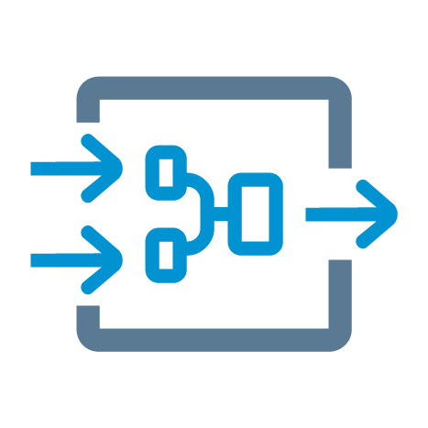



SAP Cloud Platform Solution Diagrams & Icons SAP Cloud Platform Service Icons for Slides
Analytics
Blockchain
SAP Predictive Service
SAP Analytics Cloud
Smart Business Service
SAP Streaming
Analytics
MultiChain
Hyperledger Fabric
Blockchain Application Enablement
SAP RealSpend
* read more about SAP Cloud Platform Services here … SAP Cloud Platform Help: Services

Slide 21



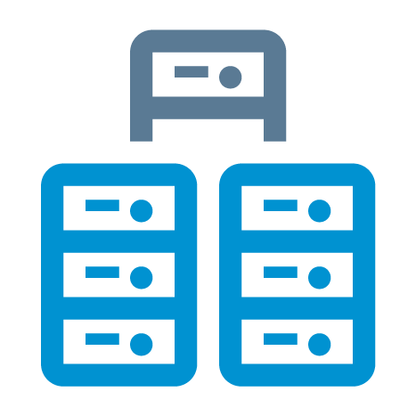




SAP Cloud Platform Solution Diagrams & Icons SAP Cloud Platform Service Icons for Slides
Collaboration
Data Management
SAP Jam
Object Store
SAP ASE
Feedback Service
Gamification
Intelligent Product Design
Big Data
Services
MongoDB
SAP HANA
PostgreSQL
Redis
* read more about SAP Cloud Platform Services here … SAP Cloud Platform Help: Services

Slide 22








SAP Cloud Platform Solution Diagrams & Icons SAP Cloud Platform Service Icons for Slides
Data Privacy & Security
Developer Experience
Authorization
& Trust
Management
Identity Directory
Platform Identity Provider
Keystore Service
Corp. Git Link for SAP Web IDE
Java Debugging
Git Service
Rapid Application Development by Mendix
SAP Web IDE
OAuth 2.0 Service
SAP Live Link 365 for Authentication
* read more about SAP Cloud Platform Services here … SAP Cloud Platform Help: Services

Slide 23













SAP Cloud Platform Solution Diagrams & Icons SAP Cloud Platform Service Icons for Slides
DevOps
Agent Activation for Dynatrace
Application Autorscaler
Application Logging
Enhanced Disaster Recovery
Feature Flags
High Availability Option
Java Apps Lifecycle Management
Job Scheduler
Monitoring Service
Performance Statistics Service
Profiling Service
Solutions Lifecycle Management
Transport Management
Custom Domains
* read more about SAP Cloud Platform Services here … SAP Cloud Platform Help: Services

Slide 24



SAP Cloud Platform Solution Diagrams & Icons SAP Cloud Platform Service Icons for Slides
Globalization
Document Management
SAP Localization Hub, Tax Service
SAP Translation Hub
SAP Document Center
Document Service
* read more about SAP Cloud Platform Services here … SAP Cloud Platform Help: Services

Slide 25














SAP Cloud Platform Solution Diagrams & Icons SAP Cloud Platform Service Icons for Slides
Integration
Internet of Things
API Management
SAP API Business Hub
SAP Banking API
SAP Enterprise Messaging
Internet
Of Things
SAP Remote Data Sync
SAP Asset
Intelligence Network
SAP IoT Application Enablement
Cloud Integration
Connectivity
OData Provisioning
Open Connectors
RabbitMQ
Digital Content Hub
Destination
Backend Service
* read more about SAP Cloud Platform Services here … SAP Cloud Platform Help: Services

Slide 26


SAP Cloud Platform Solution Diagrams & Icons SAP Cloud Platform Service Icons for Slides
Machine Learning
Master Data
SAP Leonardo
Machine Learning Foundation
SAP Data Quality Management, microservices for location data
* read more about SAP Cloud Platform Services here … SAP Cloud Platform Help: Services

Slide 27





SAP Cloud Platform Solution Diagrams & Icons SAP Cloud Platform Service Icons for Slides
Mobile
Orchestration
Agentry
Development & Operations
SMS Messaging
Fiori Mobile
Business Rules
Workflow
* read more about SAP Cloud Platform Services here … SAP Cloud Platform Help: Services

Slide 28


SAP Cloud Platform Solution Diagrams & Icons SAP Cloud Platform Service Icons for Slides
Output Management
Rates & Measures
Live Link for IN365-Email
Forms by Adobe
Market Rates Management
* read more about SAP Cloud Platform Services here … SAP Cloud Platform Help: Services

Slide 29





SAP Cloud Platform Solution Diagrams & Icons SAP Cloud Platform Service Icons for Slides
Runtimes & Containers
User Experience
Application Runtime
Functions
Java Server
Virtual Machines
Portal
SAP Build
UI Theme Designer
* read more about SAP Cloud Platform Services here … SAP Cloud Platform Help: Services

Slide 30






SAP Cloud Platform Solution Diagrams & Icons SAP Cloud Platform Service Icons for Slides
User Management
Extras
Identity Authentication
Identity Provisioning
Generic Service Icon
cloud connector
Data Provisioning Agent
ABAP environment
* read more about SAP Cloud Platform Services here … SAP Cloud Platform Help: Services

Slide 31


































SAP Cloud Platform Solution Diagrams & Icons Other SAP Icons (from SAP Icon Font, TNT Font based on SAP Fiori Iconography)
Most used icons:
On-premise
system
system, host
User
Admin
Monitor
Laptop
iPhone
iPad
Application or Package
Database
E-mail
Security
SAPUI5
SAPUI5
Global Account
Subaccount
Locked
Unlocked
Linked
Unlinked
Forward
Cloud Foundry Space
Entitlement
Solution
Upload
Download
Cloud
Wi-Fi
Feed
Public Key
Private Key
Key Pair
Disk
CPU
RAM / Memory

Slide 32



































































SAP Cloud Platform Solution Diagrams & Icons Other SAP Icons (from SAP Icon Font, TNT Font based on SAP Fiori Iconography)

Slide 33















SAP Cloud Platform Solution Diagrams & Icons SAP Product Logos (white background style)

Slide 34














SAP Cloud Platform Solution Diagrams & Icons SAP Product Logos (black background style)

Slide 35
SAP Cloud Platform Solution Diagrams & Icons Third-Party Logos
TOC | SAP Icons & Logos | 3rd Party Logos | Slide Elements | Guidelines | Examples | Resources | Changes

Slide 36





SAP Cloud Platform Solution Diagrams & Icons Third-Party Logos – Cloud Foundry
Notes:
Image Sources:
https://www.cloudfoundry.org/logo/

Slide 37





SAP Cloud Platform Solution Diagrams & Icons Third-Party Logos – Cloud Foundry (black background)
Notes:
Image Sources:
https://www.cloudfoundry.org/logo/

Slide 38












SAP Cloud Platform Solution Diagrams & Icons Third-Party Logos – Others
Kubernetes Gardener
Notes:
Image Sources:
https://commons.wikimedia.org/wiki/File:Microsoft_Azure_Logo.svg
https://github.com/kubernetes/kubernetes/tree/master/logo
https://github.com/gardener
https://github.com/cncf/artwork/tree/master/cncf
https://cloud.google.com/press/ > Google Cloud Platform Logos

Slide 39






SAP Cloud Platform Solution Diagrams & Icons Third-Party Logos – Others (black background)
Kubernetes Gardener
Notes:
Image Sources:
https://commons.wikimedia.org/wiki/File:Microsoft_Azure_Logo.svg
https://github.com/kubernetes/kubernetes/tree/master/logo
https://github.com/gardener
https://github.com/cncf/artwork/tree/master/cncf
https://cloud.google.com/press/ > Google Cloud Platform Logos

Slide 40
SAP Cloud Platform Solution Diagrams & Icons Elements for MS PowerPoint Slides
TOC | SAP Icons & Logos | 3rd Party & Logos | Slide Elements | Guidelines | Examples | Resources | Changes

Slide 41
SAP Cloud Platform Solution Diagrams & Icons: MS PowerPoint Elements Colors (white background style)*
* SAP Cloud Platform Solution Diagrams are based on a selected subset of SAP Fiori Design Colors, see more …
R | G | B | HEX | COLOR | Color Name | Purpose | Fiori Color
66 | 124 | 172 | 427CAC |  | L0-blue | SAP Cloud Platform L0 area & service names | Primary2
0 | 146 | 209 | 0092D1 |  | L1-blue | SAP Cloud Platform L1 area | Secondary6
90 | 122 | 148 | 5A7A94 |  | L2-blue | SAP Cloud Platform L2 area | Primary2 desaturated
127 | 127 | 127 | 7F7F7F |  | Fix grey | SAP Icons, separator lines | not defined
255 or 89 | 255 or 89 | 255 or 89 | #ffffff or #595959 |  | Flex grey / white = SAP Theme Palette Color „Black, Text 1, Lighter 35%“ | Texts, arrows | not defined
26 | 152 | 152 | 1A9898 |  | Emphasize aqua | Emphasize diagram elements | Secondary7
171 | 33 | 142 | AB218E |  | Emphasize purple | Emphasize diagram elements | Secondary4
43 | 125 | 43 | 2B7D2B |  | Semantic green | Emphasize diagram elements | SemanticPositive
187 | 0 | 0 | BB0000 |  | Semantic red | Emphasize diagram elements | SemanticNegative

Slide 42
SAP Cloud Platform Solution Diagrams & Icons: MS PowerPoint Elements Colors (black background style)*
* SAP Cloud Platform Solution Diagrams are based on a selected subset of SAP Fiori Design Colors, see more …
R | G | B | HEX | COLOR | Color Name | Purpose | Fiori Color
66 | 124 | 172 | 427CAC |  | L0-blue | SAP Cloud Platform L0 area & service names | Primary2
0 | 146 | 209 | 0092D1 |  | L1-blue | SAP Cloud Platform L1 area | Secondary6
90 | 122 | 148 | 5A7A94 |  | L2-blue | SAP Cloud Platform L2 area | Primary2 desaturated
127 | 127 | 127 | 7F7F7F |  | Fix grey | SAP Icons, separator lines | not defined
255 or 89 | 255 or 89 | 255 or 89 | #ffffff or #595959 |  | Flex grey / white = SAP Theme Palette Color „Black, Text 1, Lighter 35%“ | Texts, arrows | not defined
26 | 152 | 152 | 1A9898 |  | Emphasize aqua | Emphasize diagram elements | Secondary7
171 | 33 | 142 | AB218E |  | Emphasize purple | Emphasize diagram elements | Secondary4
43 | 125 | 43 | 2B7D2B |  | Semantic green | Emphasize diagram elements | SemanticPositive
187 | 0 | 0 | BB0000 |  | Semantic red | Emphasize diagram elements | SemanticNegative

Slide 43
SAP Cloud Platform Solution Diagrams & Icons: MS PowerPoint Elements Areas (white background style)
SAP Cloud Platform, Area L0
L0-blue RGB(66/124/172)
Non-SAP-Cloud-Platform Area Flex Grey: SAP Theme Palette Color „Black, Text 1, Lighter 35%“
NOTE: automatically becomes white on black background slides
Area L1
L1-blue: RGB(0/146/209)
Area L2, dotted line
L1-blue: RGB(0/146/209)
Primary Emphasize Area aqua
Aqua: RGB(26/152/152)
Emphasize Area aqua, dotted line
Non-SAP-Cloud-Platform Area,
dotted line
Flex Grey: SAP Theme Palette Color „Black, Text 1, Lighter 35%“
Area L2
L2-blue: RGB(90/122/148)
Area L2, dotted line
L2-blue: RGB(90/122/148)
Secondary Emphasize Area purple
Purple: RGB(171/33/142)
Emphasize Area purple, dotted line

Slide 44
SAP Cloud Platform Solution Diagrams & Icons: MS PowerPoint Elements Areas (black background style)
SAP Cloud Platform, Area L0
L0-blue RGB(66/124/172)
Non-SAP-Cloud-Platform Area Flex Grey: SAP Theme Palette Color „Black, Text 1, Lighter 35%“
NOTE: automatically becomes white on black background slides
Area L1
L1-blue: RGB(0/146/209)
Area L2, dotted line
L1-blue: RGB(0/146/209)
Primary Emphasize Area aqua
Aqua: RGB(26/152/152)
Emphasize Area aqua, dotted line
Non-SAP-Cloud-Platform Area,
dotted line
Flex Grey: SAP Theme Palette Color „Black, Text 1, Lighter 35%“
Area L2
L2-blue: RGB(90/122/148)
Area L2, dotted line
L2-blue: RGB(90/122/148)
Secondary Emphasize Area purple
Purple: RGB(171/33/142)
Emphasize Area purple, dotted line

Slide 45
SAP Cloud Platform Solution Diagrams & Icons: MS PowerPoint Elements Environment Boxes
Cloud Foundry Environment
L1-blue: RGB(0/146/209)
Neo Environment
RGB(26/123/246)

Slide 46
SAP Cloud Platform Solution Diagrams & Icons: MS PowerPoint Elements Cardinality Markers
SAP Cloud Platform, Area L0 , L0-blue: RGB(66/124/172)
SAP Cloud Platform, Area L1 L1-blue: RGB(0/146/209)
SAP Cloud Platform Area L2 L2-blue: RGB(90/122/148)
Secondary Emphasize Area purple
purple: RGB(171/133/142)
Primary Emphasize Area aqua aqua: RGB(26/152/152)
Non-SAP-Cloud-Platform Area Flex Grey: SAP Theme Palette Color „Black, Text 1, Lighter 35%“

Slide 47

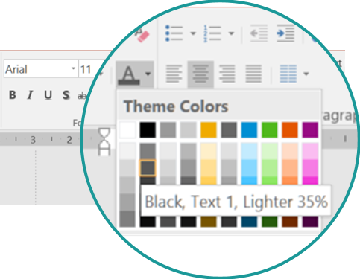
SAP Cloud Platform Solution Diagrams & Icons: MS PowerPoint Elements Text in Flex Grey (Standard Font: Arial*)
* Use standard font Arial instead of BentonSans to avoid rendering issues when sharing slide decks across channels
Copy & paste these text objects
Text in Flex grey*: SAP Theme color “Black, Text 1, lighter 35%”, Arial font
Non-service Icon text
Arial 11 bold / Flex grey: SAP Theme color “Black, Text 1, lighter 35%”)
1
Non-service Icon text
2
Descriptive text element
Arial 11 / Flex grey: SAP Theme color “Black, Text 1, lighter 35%”
Descriptive text
3
L1-L2 area header text
Arial 11 bold / Flex grey: SAP Theme color “Black, Text 1, lighter 35%”
L1-L2 area header
Component title
4
LANDSCAPE AREA TITLE
Arial 14, bold, Flex Grey: SAP Theme color “Black, Text 1, lighter 35%”
*NOTE: Flex grey automatically becomes white on black background slides
LANDSCAPE AREA TITLE

Slide 48

SAP Cloud Platform Solution Diagrams & Icons: MS PowerPoint Elements Text in L0-blue, Emphasize & Semantic Colors (Standard Font: Arial*)
* Use standard font Arial instead of BentonSans to avoid rendering issues when sharing slide decks across channels
Copy & paste these text objects
Service Icon Text
SAP Cloud Platform Service icon text
Arial 11 / L0-blue: RGB(66/124/172)
Service name
subtitle
Text in Emphasize Colors
Text in emphasize aqua: Arial 11 / RGB 26/152/152
Text in emphasize aqua
Text in emphasize purple: Arial 11 / RGB 26/152/152
Text in emphasize purple
Text in Semantic Colors
Text in semantic red: Arial 11 / RGB 187/0/0
Text in semantic red
Text in semantic green: Arial 11/ RGB 43/125/43
Text in semantic green

Slide 49
SAP Cloud Platform Solution Diagrams & Icons: MS PowerPoint Elements Connectors, Arrows & Lines
Flex grey
Emphasize aqua
Emphasize purple
Semantic green
Semantic red
Elbow Connectors
Line Connectors
Arrow Types
Standard: Request-response from client to server (solid line)
Information-flow from data source to target (dashed line)
Bidirectional arrow, e.g. for mutual trust relation (solid line)
Landscape Separators
Firewall
Arrow Annotation
Flex grey: SAP Theme color “Black, Text 1, lighter 35%”
annotation text
IMPORTANT: color in Fix grey RGB(127/127/127), but not in Flex grey to keep same on black background style!

Slide 50
SAP Cloud Platform Solution Diagrams & Icons: MS PowerPoint Elements Numbers
Numbers L2-blue: RGB (66/124/172)
1
2
3
4
5
6
7
8
9
10

Slide 51
SAP Cloud Platform Solution Diagrams & Icons Design Guidelines
TOC | SAP Icons & Logos | 3rd Party Logos | Slide Elements | Guidelines | Examples | Resources | Changes

Slide 52


SAP Cloud Platform Solution Diagrams & Icons – Design Guidelines Arrow Directions in SAP Cloud Platform Solution Diagrams
Request-Response Channel: Solid arrow from client (triggering agent) to server (Point-to-Point Connectivity Scenario, simplified)
Data Flow Channel: Dashed arrow from source (triggering agent) to target database (data replication scenario, simplified)
Application request arrow with solid line
SAP Cloud Platform HANA database as a service
Data flow arrow with dashed line
Service request
System
On-premise database (source)
HTTPS
SAP Gateway
Data Replication Tool
Database
OData
TCP
ODBC
SAPUI5 application
Connectivity service
Cloud Connector
Protocol
Exposed OData service interface
Connectivity service
Cloud Connector
Protocol
ODBC interface needed for replication process
Mutual Trust Relation: Solid arrow in both directions
Bi-directional RFC: Solid arrow in both directions ( Point-to-point connectivity scenario with Cloud Connector 2.10)
Mutual trust relation
Backend system
Protocol
NEO Environment
RFC
SAP S/4HANA Cloud system
mutual trust
Cloud Connector
Bi-directional RFC via tunnel connection
SAP Cloud Identity (Identity Provider)
Notes:
Agents perform operations; they read and write data and communicate with other agents. (Question: Who does something?)
Storages are passive; they only hold data that is accessed by agents. The arrows indicate direction of data flow. (Q: Where is the data?)
Channels are used by agents to communicate with each other. Arrows indicate the direction of data flow, the “R” indicates who initiates the request and then waits for the response. (Q: Which agents communicate? What data and which requests do they exchange?)
Block diagrams show a snapshot view of a system on instance level; to indicate multiple agents or storages, use three dots or stack the nodes.

Slide 53


SAP Cloud Platform Solution Diagrams & Icons: Design Guidelines Graphical Elements to depict Application Protocols, Interfaces and Trust Relationships
Application Protocol
Sample 1
Sample 2
Application protocol
HTTP
Cloud Connector
Application Server ABAP
Application client
SAPUI5 Application
RFC
RFM/BAPI
< protocol name >
Application protocol
Application interface
Application Interface
Sample 1
Application interface
Sample 2
OData/Rest
Java Application
Application interface
SAP Cloud Applications
<interface name>
Application component
SAP Cloud Platform SDK for service development
Custom Code
Java API
OData
Trust Relationship
Sample
SAP Cloud Applications
trust
trust
Mutual trust relationship

Slide 54

SAP Cloud Platform Solution Diagrams & Icons – Design Guidelines Graphical Style to Show the Inner Part of an Application or Service
GUIDELINE: Place the service icon (or icon of another technical component, e.g. application) at the edge of a new rectangle that contains inner parts of the service. Fill the service icon with white color (or slide background color) to hide the edge line of the rectangle underneath. Place inner parts of the service inside the rectangle.
Sample 1
Service icon (filled white) is placed at the upper edge of the blue rectangle
Sample 3
Inner resource, here a Scale application
Application icon (filled white) is placed at the upper edge of the grey rectangle for “Application Client”
Blue rectangle wraps resources inside the service
Application Client
SAP API Business Hub
End User
Weather Report App Scala.js
SuccessFactors Recruiting APIs
OData
Inner resource, here an OData API representation
Grey rectangle wraps resource, here Scala.js app) inside the app client
Sample 2
Service icon (filled white) is placed at the upper edge of the blue rectangle
Blue rectangle wraps functions inside the service
Sample 4
Client-side Application Staticfile CF buildpack
SAP Analytics Cloud
SAP HANA Database
Modeling
Predictive
Application icon (filled white) is placed at the upper edge of the grey rectangle for “Client-side App”
Live connection
GeoServer Erlang
Text & Search
Spatial

Slide 55
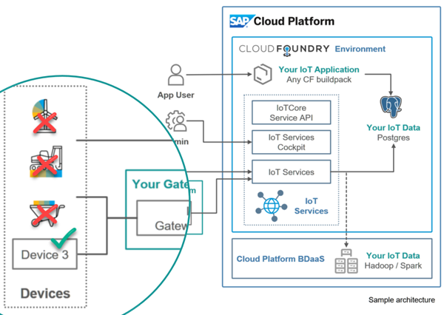
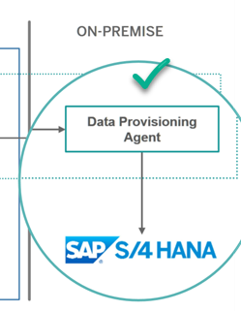
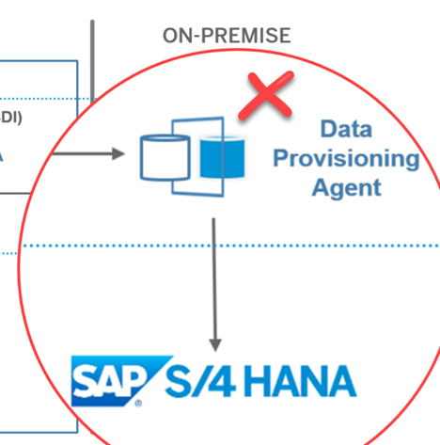
SAP Cloud Platform Solution Diagrams & Icons – Design Guidelines Do’s and Don’ts (1)
Do not mix up different icon designs. E.g. SAP banded-color Icons mixed up with SAP Cloud Platform solution icons in the same diagram
Do not create own new icons, but use simple text boxes instead. Request new icons in “SAP Cloud Platform User Community”

Slide 56
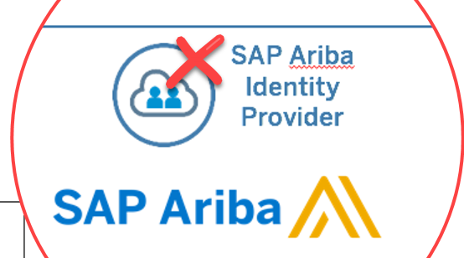
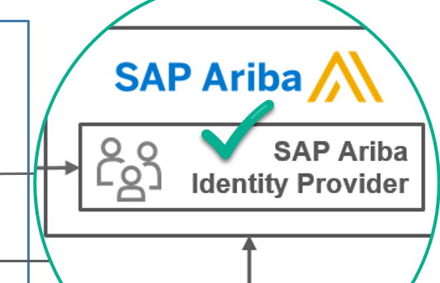
SAP Cloud Platform Solution Diagrams & Icons – Design Guidelines Author Guidelines: Do’s and Don’ts (2)
Do not reuse SAP Cloud Platform Service Icons outside the SAP Cloud Platform environment. Use text boxes instead.

Slide 57
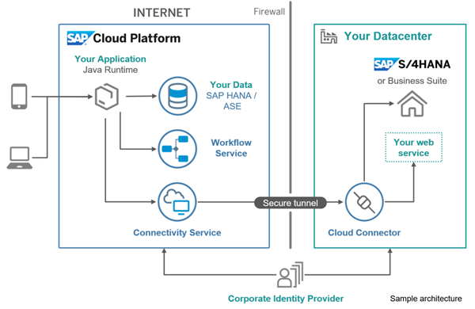
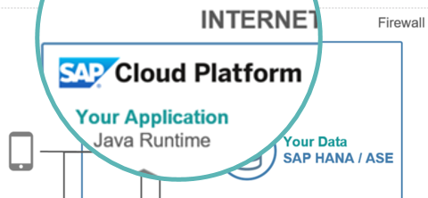
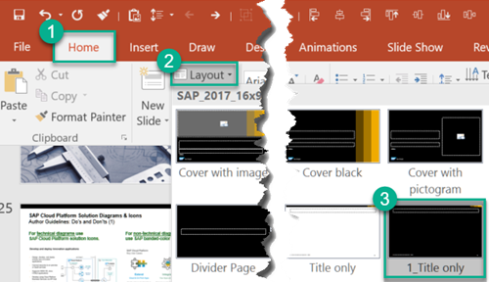
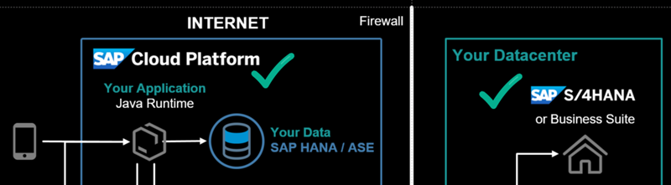
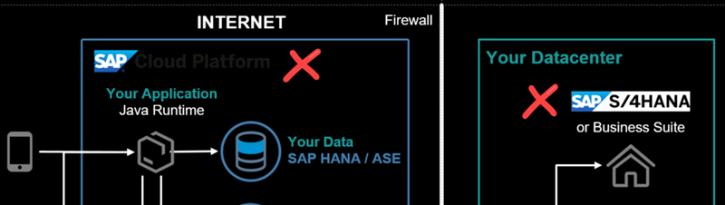
SAP Cloud Platform Solution Diagrams & Icons – Design Guidelines Do’s and Don’ts (4)
Use emphasize colors to visually highlight important parts of the solution diagram.
Replace logo images when You switch to black background style*.
* [On Windows] select slide layout with shortcut ALT+H and L
3
1
2
4
5

Slide 58
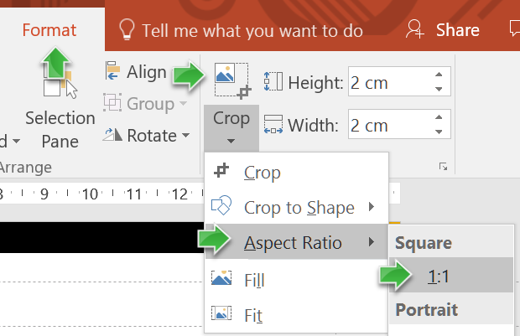
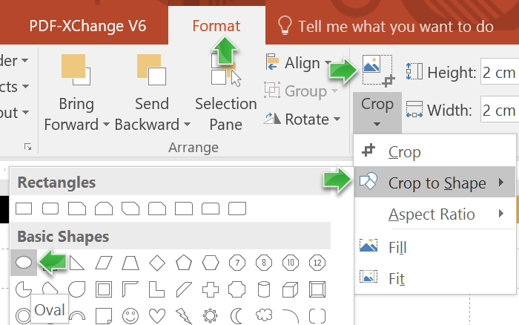
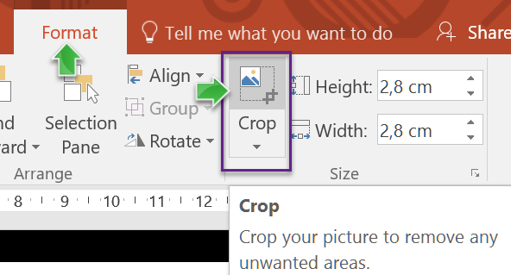
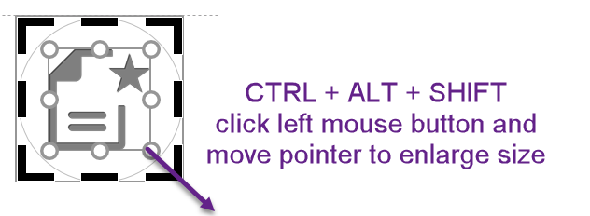
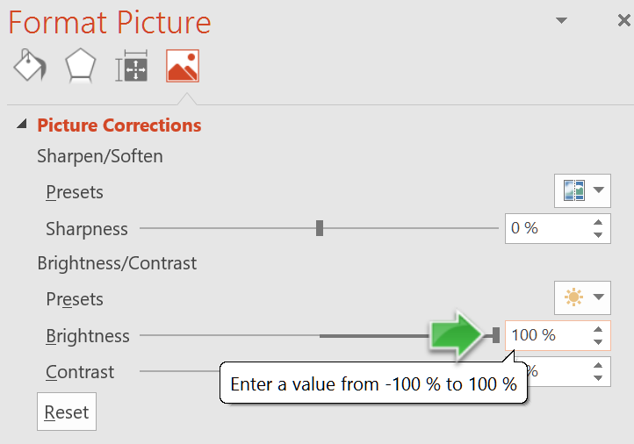

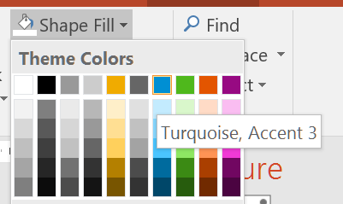
SAP Cloud Platform Solution Diagrams & Icons – Design Guidelines How to create Colored Icons in 5 Steps Solution Diagram example with colored icons: see slide SAP Cloud Platform Solution Diagram Examples > Principal Propagation
1
Set aspect ratio to 1:1
2
Crop to shape “circle”
3
Enlarge crop area
start with grey icon
5
Set 100% brightness
4
Fill shape with color
end with colored icon

Slide 59
SAP Cloud Platform Solution Diagrams & Icons – Design Guidelines Tips & Tricks for using MS PowerPoint (1)
[On Windows] Use little-known keyboard shortcuts for fast editing
MUST USE THIS! Copy & paste formatting of one or many shapes/texts/objects to one or many selected (or highlighted) other ones with CTRL+SHIFT+C and CTRL+SHIFT+V.
Duplicate an object with CTRL+D or with CTRL+SHIFT+Left Mouse Button.
Quickly center text with CTRL+E. Go back to left or right align with CTRL+L or CTRL+R.
Clear formatting with CTRL+Spacebar.
Group multi-selected objects with CTRL+G. Ungroup with CTRL+SHIFT+G.
[On Mac] Use little-known keyboard shortcuts for fast editing
MUST USE THIS! Copy & paste formatting of one or many shapes/texts/objects to one or many selected (or highlighted) other ones with CMD(⌘)+SHIFT+C and CMD(⌘)+SHIFT+V.
Duplicate an object with ⌘+D.
Quickly center text with ⌘+E. Go back to left or right align with ⌘+L or ⌘+R.
Clear formatting with ⌘+Spacebar.
Group multi-selected objects with ⌘ +ALT+G. Ungroup with ⌘ +ALT+SHIFT+G.

Slide 60

SAP Cloud Platform Solution Diagrams & Icons – Design Guidelines Comparison with SAP TAM Block Diagrams (1)
SAP TAM Block Diagrams |  | SAP Cloud Platform Solution Diagrams
Purpose: Most important diagram type to describe architecture. Use it to show the static structure of the system, and to provide a big picture view. |  | Purpose: domain-specific diagram type to describe SAP Cloud Platform solution scenarios across IT landscapes. Show used Cloud Platform services, environments, used systems and their interdependencies.
Agents process information, communicate via channels, access storages |  | Agents, systems, SAP Cloud Platform services depicted as blue circled icons, grey icons or colored boxes
Storages contain information accessed by agents. |  | Storage visualized either as corresponding SAP Cloud Platform database as a service icon or as rounded box for non-SAP-Cloud-Platform storages (e.g. on-premise database).
Channels are used to transport information between agents Request-response Channels show the direction of the Request, indicating the triggering agent (=the Client) Modifying Access: A can read and write storage content Read-only Access: A can only read storage content |  | Arrows are used to express “interdependencies” between services, components, users, or systems including request/response channels, usage relations, data flows (e.g. for data replication, but with dashed line), or trust relations. The standard interdependency is a request/response channel pointing from client to server (with solid line arrow). For mutual relations like a mutual trust relation from one system to another a bidirectional, solid line arrow is used. No visual difference between modifying and read-only access types, use text annotation to provide additional details that are not represented visually (e.g. a modifying read & write access) or decide to use TAM block diagrams instead. For more details on arrow directions: see previous slide!
Further Notes: Use class diagrams to show how data relates that is located in storages or exchanged via channels. Use activity or sequence or state diagrams to express the behavior of agents and how they interact. |  | Further Notes: Use SAP TAM Diagrams for a technically more detailed SAP Cloud Platform solution architecture
Agent
SAP Cloud Platform service
User Persona
Agent
Storage
Storage
SAP HANA Database
A1
A2
Client
R
Server
A
S
A
S

Slide 61
SAP Cloud Platform Solution Diagrams & Icons – Design Guidelines Comparison with SAP TAM Block Diagrams (2)
SAP TAM Block Diagram Example
SAP Cloud Platform Solution Diagram Example
Customers
Customers
...
...
Register Edit Profile Browse Orders
Search Get Prod. Info Select Items
Place Order Cancel Order
Register Edit Profile Browse Orders
Search Get Prod. Info Select Items
Place Order Cancel Order
R
R
R
Service Provider
Online Shop: SAPUI5 Applications
Online Shop Server
Service Provider
Customer Account Maintenance
Product Presentation + Selection
Order Processing
Credit Card Institutions
Customer Account Maintenance
Product Presentation + Selection
Order Processing
R
Credit Card Institutions
Shipping
Shipping
Customer’s product selection
Customer’s product selection
SAP HANA Database
REST
...
...
Credit Card Institutions
Suppliers
Connectivity
ERP data
...
SAP S/4HANA on-premise
Firewall
Customer data
Product Information
Product Availability
Orders
Shop Data
OData
Cloud
Connector

Slide 62
SAP Cloud Platform Solution Diagrams & Icons Solution Diagram Examples
TOC | SAP Icons & Logos | 3rd Party Logos | Slide Elements | Guidelines | Examples | Resources | Changes

Slide 63

SAP Cloud Platform Solution Diagram Examples SAP Fiori Cloud
Diagram source: SAP Cloud Platform Blueprints > Modernizing the Employee User Experience with SAP Fiori Cloud
INTERNET
Firewall
End User
Your Datacenter
Subaccount
or Business Suite
Design time environments
OData Provisioning*
SAP Gateway*
Application Client
Fiori Configuration Cockpit (FCC)
UI theme designer
SAP Web IDE
SAP Build
iOS
Fiori apps & content
option 1
option 2
Secure tunnel
Android
Portal
SAP Fiori launchpad
Connectivity service
Cloud connector
Windows
trust
Desktop
Identity Authentication tenant
* OData services via SAP Cloud Platform OData provisioning or SAP Gateway (see details about deployment options in SAP Enterprise Architecture Explorer (#11115) and in SAP Note 1830712)
Notes:
Enable modern and intuitive user experience for SAP users
Quickly deploy packaged content for SAP S/4HANA and Business Suite
Design, develop, extend and mobilize SAP Fiori apps in the cloud
Extend apps using SAP Web IDE Fiori extension model
Connect securely via internal or external access point
Operations and updates by SAP

Slide 64


SAP Cloud Platform Solution Diagram Examples Extend SAP cloud applications
SAP Cloud Applications
Mobile services
Your Application Java or SAPUI5
OData
Connectivity
Custom Data SAP HANA instance
Corporate Identity Provider

Slide 65
SAP Cloud Platform Solution Diagram Examples Extend SAP cloud applications including SAP S/4HANA Cloud Explore SAP S/4HANA Cloud Extensibility options by leveraging the sample scenarios from SAP: http://sap.com/extends4
SAP Cloud Applications
Your Application ABAP, Java or node.js and SAPUI5
OData
Application Clients
Connectivity
Custom Data SAP HANA instance
Corporate Identity Provider

Slide 66
SAP Cloud Platform Solution Diagram Examples Extend SAP SuccessFactors applications Browse Use Cases on cloudplatform.sap.com: Use Case Finder > SAP SuccessFactors
SAP Cloud Applications
Mobile services
trust
Your Application Java or SAPUI5
OData
Portal
Connectivity
Your Datacenter
Custom Data SAP HANA instance
Corporate Identity Provider

Slide 67
SAP Cloud Platform Solution Diagram Examples Extend SAP SuccessFactors applications Browse Use Cases on cloudplatform.sap.com: Use Case Finder > SAP SuccessFactors
Application Client
SAP Cloud Applications
Subaccount
Your Application Java or SAPUI5
Mobile
Mobile services
End User
Desktop
OData
Portal
Custom Data SAP HANA instance
Connectivity
Your Datacenter
trust
Identity Authentication tenant
Corporate Identity Provider

Slide 68
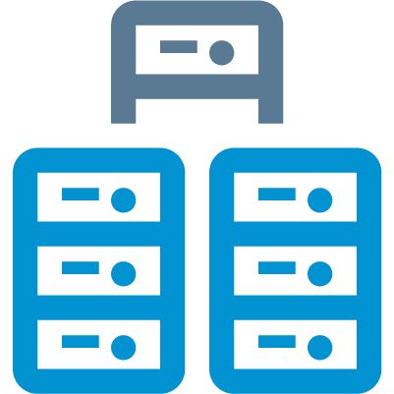
SAP Cloud Platform Solution Diagram Examples SAP Leonardo IoT Foundation & Edge
INTERNET
Your IoT application
Hardware Gateway
SAP Web IDE
Portal SAP Fiori Launchpad
SAP Leonardo IoT
SAP Leonardo IoT Edge
Cloud Foundry Environment
SAP & Non SAP Applications
SAP Edge Services
SAP Leonardo IoT Foundation
SAP Cloud Platform Internet Of Things (Core)
SAP IoT Application Enablement
run on
Data Ingestion Pipeline
Sensor embedded things
IoT Gateway Edge*
SAP Cloud Platform Integration
and more …
Your IoT Data Swift I Cassandra** I SAP HANA
*Belongs to SAP Cloud Platform Internet of Things
**Support of SAP Vora planned.

Slide 69
SAP Cloud Platform Solution Diagram Examples Analytical Application based on SAP HANA database Browse Use Cases on cloudplatform.sap.com: https://cloudplatform.sap.com/scenarios/usecases/analytics-cloud.html
INTERNET
Firewall
SAP Cloud Applications
Your Datacenter
Your Services
Your Application
Smart Business Service
Portal
On-premise
system
SAP HANA Database
Modeling
Predictive
Live connection
Secure tunnel
Text & Search
Spatial
Connectivity
Cloud connector
SAP Analytics Cloud
Corporate Identity Provider

Slide 70
SAP Cloud Platform Solution Diagram Examples Develop and deploy innovation applications (white background style)
INTERNET
Firewall
Your Datacenter
Your Application Java Runtime
or Business Suite
Your Data SAP HANA / ASE
Workflow
Your web service
Secure tunnel
Connectivity
Cloud Connector
Corporate Identity Provider

Slide 71
SAP Cloud Platform Solution Diagram Examples Develop and deploy innovation applications (black background style)
INTERNET
Firewall
Your Datacenter
Your Application Java Runtime
or Business Suite
Your Data SAP HANA / ASE
Workflow
Your web service
Secure tunnel
Connectivity
Cloud Connector
Corporate Identity Provider

Slide 72
SAP Cloud Platform Solution Diagram Examples Leverage Cloud Foundry to create innovative applications
INTERNET
Firewall
Your Datacenter
Your Application any buildpack
Your Service 1 using SAP HANA / ASE
or Business Suite
Your Service 2 using Redis
Your Service 3 using MongoDB
Secure tunnel
Connectivity Service
Cloud Connector
¹ Open source CF buildpacks are community supported ² Beta component
Corporate Identity Provider

Slide 73
SAP Cloud Platform Solution Diagram Examples DevOps in SAP Cloud Platform
INTERNET
commit
SAP Web IDE
Git Service
CI Server (e.g. Jenkins)
Artifact Repository
Eclipse IDE
Your Application
Virtual Machine
deploy

Slide 74
SAP Cloud Platform Solution Diagram Examples SAP Cloud Platform API Management Browse Use Cases on cloudplatform.sap.com: https://cloudplatform.sap.com/scenarios/usecases/monetize-apis.html
INTERNET
Firewall
ON-PREMISE
User network
Your Digital Applications
Your Microservices
or Business Suite
External Developer
SAP Gateway
Partner
API Management
Secure tunnel
Internal Developer
Connectivity
Cloud Connector
Your Datacenter
3rd Party Cloud APIs
Corporate Identity Provider
Your Applications

Slide 75
SAP Cloud Platform Solution Diagram Examples Gaining Consumer Insights: Reference Architecture Overview
USER NETWORK
INTERNET
ON-PREMISE
Smart Data Integration (SDI)
Data Provisioning Agent
End user
Mobile client
mobile service
for development and operations
SAP HANA Database
1
User provides credentials
trust
Redirect the request for authentication
2
SAP Cloud Platform Identity Authentication Service
3
4
Perform authentication
Redirect to the mobile app

Slide 76

SAP Cloud Platform Solution Diagram Examples SAP Cloud Connector 2.10: What’s new in it?
ON-PREMISE LANDSCAPE
INTERNET
Firewall
Region host
SAP Cloud Platform subaccount
HTTPS
Cloud Connector admin user
admin connection
On-premise systems
Cloud Connector
SAP S/4HANA Cloud
Bi-directional RFC via tunnel connection
SAP S/4HANA
Cloud system
SAP S/4HANA Cloud tenant
RFC
Key User
HTTPS
tunnel

Slide 77





SAP Cloud Platform Solution Diagram Examples SAP‘s modular IoT platform in cloud
SAP Leonardo for IoT
SAP Leonardo for IoT Bridge*
Dashboard | Collaboration
SAP Leonardo IoT Edge
Local data processing
Micro services
Business essential functions
SAP Leonardo for IoT Foundation
SAP & non-SAP Business Applications
Technical Services
Device management
Connectivity
Messaging
Data Management
Aggregate store
Times series store
Data archive
Business Services
Thing modeler
IoT app development
Re-use UI and APIs
and more …
Sensor embedded things
Integration I Analytics I Machine Learning I Security I Orchestration and more
*Future scope

Slide 78
SAP Cloud Platform Solution Diagram Examples Typical S/4HANA Extension Patterns: Hub applications
INTERNET
ON-PREMISE ENTERPRISE NETWORK
Firewall
SAP S/4HANA on-premise
End user
HTTPS
OData service
SAP Gateway
Hub Application in Java
Connectivity service
Cloud Connector
HTTPS
Application Server ABAP
RFC
HTTPS tunnel
RFC
RFM/BAPI
Application Client
TCP
ODBC
Data Replication Tool
Replicate on-premise database to cloud database
Database
SAP Cloud Platform service
Cloud database

Slide 79





SAP Cloud Platform Solution Diagram Examples Principal Propagation
Note: For practical details see Author Guidelines: How to create Colored Icons in 5 Steps
INTERNET
Firewall
ON-PREMISE CORPORATE NETWORK
Client
Secure tunnel
5
Operating System (OS)
Company root CA
: John Doe
: John Doe
Cloud Connector
SAP Gateway
Private root CA
Cloud Connector system
Server SSL standard
Cloud Connector UI
Private root CA
1
: John Doe
Cloud Connector local CA
6
Operating System (OS)
: John Doe
Company Root CA
: John Doe
SAP Web IDE
SAP Backend
2
4
Private Root CA
: John Doe
Identity Authentication service
Application
LEGEND
Certificate signed by the Cloud Connector local CA*
Certificate
Identity from the Identity Provider
Certificate signed by the
private root CA*
Root certificate
Identity from the SAP system
3rd party Identity Provider
3
: John Doe
Intermediate or
CA* certificate
Certificate signed by the
company root CA*
Short-lived certificate
*CA: certificate authority

Slide 80
SAP Cloud Platform Solution Diagram Examples Weather Demo: Developed Using the "Bring Your Own Language" Concept Browse Code Sample on GitHub: https://github.com/SAP/cloud-cf-byol-weather-sample
INTERNET
Cloud Foundry Environment
deploy
App Developer
Client-side Application Staticfile CF buildpack
Server-side Application Community CF buildpack
Application Client
Weather Report App Scala.js
send on startup
HTTPS
GeoNames.org
geographical database
End User
Weather Report App Scala.js
GeoServer Erlang
OpenWeatherMap.org
OpenStreetMap.org

Slide 81
SAP Cloud Platform Solution Diagram Examples Achieve Budget and spend Visibility by Extending SAP S/4HANA Cloud Browse Use Cases on cloudplatform.sap.com: https://cloudplatform.sap.com/scenarios/usecases/extend-s4cloud.html
INTERNET
Subaccount in Cloud Foundry environment
Connectivity
HTTP
OData API
HTTP
HTTP
SAPUI5 App
Application Clients
OData/Rest
Java Application
SAP Cloud Platform SDK for service development
Custom Code
S/4HANA Cloud SDK
Java API
Java API
OData API
SAP ASE
trust
trust
Corporate Identity Provider

Slide 82
SAP Cloud Platform Solution Diagram Examples Recruitment Travel & Expense Management Dashboard Browse Use Cases on cloudplatform.sap.com: https://cloudplatform.sap.com/scenarios/usecases/travel-expense.html
SAP Cloud Applications
Manager
Subaccount in Cloud Foundry environment
SAP API Business Hub
SuccessFactors Recruiting APIs
Microservices
OpenAPI
OData
OData
REST
Application client
SAPUI5 application
Concur Expense APIs
OData
OData

Slide 83
SAP Cloud Platform Solution Diagrams & Icons Resources
TOC | SAP Icons & Logos | 3rd Party Logos | Slide Elements | Guidelines | Examples | Resources | Changes

Slide 84
SAP Cloud Platform Solution Diagrams & Icons Resources
SAP Cloud Platform Solution Diagrams & Icons wiki
Be Visual! Use Official Icons and Samples for SAP Cloud Platform Solution Diagrams sap.com community blog, January 5th 2018
SAP Cloud Platform Capabilities & Services: https://cloudplatform.sap.com/capabilities.html
SAP Cloud Platform Help on Services and Capabilities
SAP Cloud Platform Blueprints (as part of scenario use cases) containing solution diagrams https://cloudplatform.sap.com/scenarios.html

Slide 85
SAP Cloud Platform Solution Diagrams & Icons Version Change History
TOC | SAP Icons & Logos | 3rd Party Logos | Slide Elements | Guidelines | Examples | Resources | Changes

Slide 86
What's New in Official SAP Cloud Platform Solution Diagrams & Icons Guidelines v02 from September 19th 2017
ICONS
New service icons: Security: Identity Directory / Collaboration: SAP Jam
New most used icons: "Global Account", "Space", "Subaccount", "Entitlement", "Wi-Fi", "Feed"
New other icons: diverse document icons
Changed service names: deprecated = SAP Cloud Platform <Remote Data Sync, Predictive services, Streaming Analytics, Build, Enterprise Messages>; new = SAP <Remote Data Sync, Predictive services, Streaming Analytics, Build, Enterprise Messages> service
Changed service icon designs: Mobile services - Agentry, Development & Operations
Changed: 3rd party "Mendix" logo replaced with SAP RAD by Mendix icon, moved to Dev/Ops capability
Changed all service/capability icon texts: Increased font size for icon texts from 9pt to 11pt
GUIDELINES
New Cardinality Markers to visualize multiple instances of an area/component (e.g. "accounts")
New Connectors, Arrows & Lines: introduced new "Arrow Types" to differ between request/response arrows (solid line) and information flow arrows (dashed line)
Updated Author Guidelines to reflect two different arrow types (comparison with SAP TAM Block diagrams).
New author guideline on "arrow directions" (dashed line versus solid line)
DIAGRAMS
New sample diagram: "Typical S/4HANA Extension Patterns: Hub applications", arrow directions (dashed line for data replication, showing interfaces like "OData service" exposed via SAP Gateway)
New sample diagram: "Principal Propagation", colored certificate icons, legend

Slide 87
What's New in Official SAP Cloud Platform Solution Diagrams & Icons Guidelines v03 from December 21st 2017
GENERAL
Changed (21.12.2017): adapted footnote on all slides “The SAP Cloud Platform Diagrams, Design Elements & Icons may be used to create own solution diagrams for SAP Cloud Platform solution scenarios, see terms of use document ….”
New (21.12.2017): Added slide “Terms of Use for SAP Cloud Platform Solution Diagrams, Design Elements and Icons”
ICONS
New: Other Icons: three key icons for "private key", "public key" and "key pair“
Modified: Service Icons: higher resolution of "service icons for "SAP Web IDE" and “SAP Jam”
New: Service Icons: “Digital Content Hub” (Integration)
GUIDELINES
New: added author guideline on "How to create Colored Icons in 5 Steps"
DIAGRAMS
Modified: SAP Fiori Cloud (solution diagram example): added two services "UI theme designer" and "SAP Web IDE".
Added: link to diagram source "SAP Cloud Platform Blueprints > Modernizing the Employee User Experience with SAP Fiori Cloud“
Corrected: changed font BentonSans to Arial in arrow annotations of sample diagram “SAP Cloud Connector 2.10: What’s new in it?“

Slide 88
What's New in Official SAP Cloud Platform Solution Diagrams & Icons Guidelines v04 from February 22th, 2018
GENERAL
Adapted footnote on all slides, linked to terms of use
Added link to blog ”Be Visual! Use Official Icons and Samples for SAP Cloud Platform Solution Diagrams”, sap.com, Bertram Ganz, 5.1.2018
ICONS
New capability icon: Blockchain
New grouping icons: Pricing, Infrastructure
New service icons: Integration: Destination (CF) service / Business Services: “Personal Data Manager”, ”SAP Localization Hub, Tax Service”, “Multichain”
New „Other SAP icons, most used“: Disk Storage, Memory, CPU, SAP Cloud Platform Solution, pdf-attachement, sys-help, learning-assistant
Modified: Business Services icons: Changed Icon text from “Tax Service” to “SAP Localization Hub, Tax Service” / from “Data Quality Services” to “SAP Data Quality Management, microservices for location data (DQM Microservices)”
Changed: SAP HANA DB metaphor changed to „column-based“ and „cloud“, SAP ASE DB metaphor changed to „row-based“ and „cloud“
Deprecated: Mobile services icons: App & Device Management, Fiori Mobile
SAP LOGOS
Modified: Replaced all SAP product logos with new designs, SAP logo before product names replaced with text “SAP”
New logos: Added “SAP Concur” logo, “SAP S/4HANA Cloud” logo
GUIDELINES
New: Added “Environment Boxes” for “Cloud Foundry” & “Neo Environment” (without logos, in different blue colors)
DIAGRAMS
Updated sample diagrams: in 3 diagrams “Extend SAP cloud applications / SAP cloud applications including SAP S/4HANA Cloud / SAP SuccessFactors applications”: replaced SAP HANA icon with updated one
New Sample Diagram: Analytical Application based on SAP HANA database

Slide 89
What's New in Official SAP Cloud Platform Solution Diagrams & Icons Guidelines v05 from July 23, 2018
GENERAL
n/a
ICONS
Updated Capability Category icons: deleted: Business Services (NOTE: contained services are now part of other capability categories); renamed: Data & Storage to Data Management, Pricing to Commercialization, Security to User Management; refined icon design: Data Management, User Management (was named "Security" before), DevOps; new categories: Data Management, Data Privacy & Security, Developer Experience, Document Management, Globalization, LoBs & Industries, Master Data, Rates & Measures, Orchestration, Output Management, Added “Machine Learning” (6.9.18)
New service icons: Collaboration: “Intelligent Product Design”, Data Privacy & Security: “SAP Live Link 365 for Authentication”, Rates & Measures: "Market Rates Management“
New „Other SAP icons, most used“: Data Provisioning Agent
Replaced service icon: SAP Leonardo Machine Learning Foundation
Modified icons: replaced generic service icon with hq version, added colored SAPUI5 application icon (on “Other Icons” slide)
Renamed services: service “Applications Logs” now is “Logging Services”, “Intelligent Notification 365 Email“ now is “Live Link for IN365-Email”, “Debugging Service” now is “Java Debugging”, “SAP Leonardo Machine Learning” now is “SAP Leonardo Machine Learning Foundation”
SAP LOGOS
Modified: n/a
New logos: n/a
3rd PARTY LOGOS
Replaced logos: amazon web services (aws), Cloud Foundry
Replaced logos, 5.9.2018: Microsoft Azure
Deleted logos, 5.9.2018: Google Cloud Platform
Added new logos for black and white slide backgrounds: Open Service Broker API, Cloud Native Computing Foundation, kubernetes, kubernetes Gardener
GUIDELINES
New: n/a
DIAGRAMS
Updated sample diagrams: SAP Fiori Cloud scenario (added design time environment box, added Fiori Configuration Cockpit, added arrow annotations for OData options, added footnote text)
New sample diagrams: SAP Cloud Platform API Management; Weather Demo: Developed Using the "Bring Your Own Language" Concept
Updated sample architecture: Renamed Solution Diagram Example "Internet Of Things innovation" to "SAP Leonardo IoT Foundation & Edge“. Updated to new “Standard IoT Cloud Architecture”, including “IoT Application Enablement”, “Data Ingestion Pipeline”, “SAP Leonardo IoT Edge”

Slide 90
What's New in Official SAP Cloud Platform Solution Diagrams & Icons Guidelines v06 from December 12th, 2018
GENERAL
n/a
ICONS
Changed service icon: Blockchain: Application Enablement
Modified service icon: SAP Web IDE icon now has blue color (no longer grey)
Added service icons: Integration: Open Connectors, Backend Service, Digital Content Hub / Runtimes & Containers: Application Runtime, Functions / DevOps: Agent Activation for Dynatrace, Enhanced Disaster Recovery, High Availability Option, Transport Management
Extras: added “ABAP Environment” icon
SAP LOGOS
Deprecated: SAP Hybris
New: SAP C/4HANA
Modified: n/a
3rd PARTY LOGOS
New: Alibaba Cloud
GUIDELINES
Renamed: section “Author Guidelines” is now named “Design Guidelines”
New: 2 “Design Guideline” slides on “Graphical Style to Show the Inner Part of an Application or Service” and “Graphical Elements to depict Application Protocols, Interfaces and Trust Relationships”
DIAGRAMS
Updated sample diagrams: added links to related cloudplatform.sap.com use cases or GitHub samples.
Updated sample diagrams: in “Gaining Consumer Insights: Reference Architecture Overview” replaced “Data Provisioning Agent” box with new circled icon / “Extend SAP SuccessFactors applications”: Corporate Identity Provider is now contained in Corporate Network.
Updated sample diagrams: replaced all “SAP Hybris” logos with new “SAP C/4HANA” product logo / replaced all “SAP Web IDE” icons with new blue version (grey before)
New sample diagrams: A/ “Increased Visibility into Budget and Spending by Extending SAP S/4HANA Cloud”, B/ “Recruitment Travel & Expense Management Dashboard”

Slide 91



https://www.sap.com/community/topic/cloud-platform.html
https://cloudplatform.sap.com
http://twitter.com/sapcp
Thank you.
SAP Cloud Platform Solution Diagrams Contacts for Customers & Partners
Bertram Ganz bertram.ganz@sap.com

